Slide 1
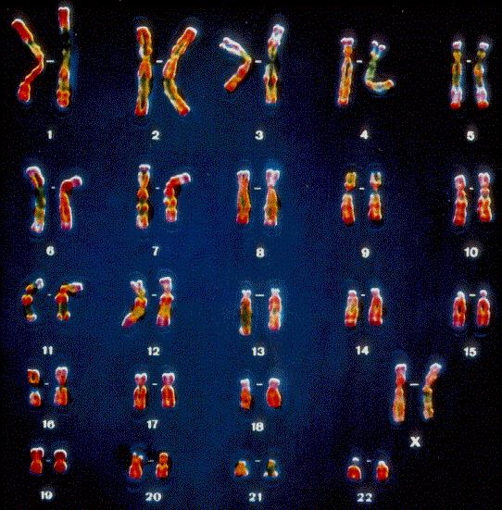
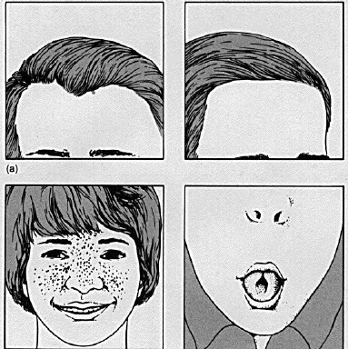
Aim: How are traits of living things inherited?
G
E
N
E
T
I
C
S

Slide 2
Genetics & Ethics
Aim: What are some of the ethical issues in genetics?
Do Now:
Why is red hair so rare?
How can two parents with brown hair have a child with blonde hair?
Mini Class Activity: PTC strips
Group Work: Genetics Case Cards
-PTC strips
Exit Ticket: Hand in group work on case card
Homework: Genetics Packet

Slide 3
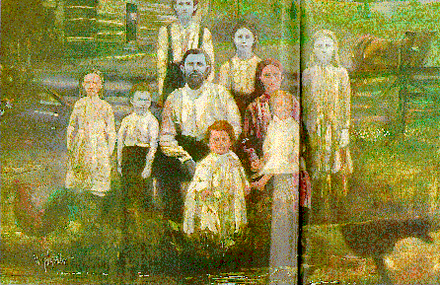
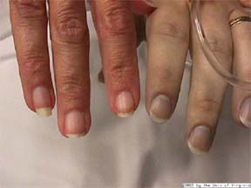
The Fugate Family
Martin Fugate and four of his children have blue skin!
This is a picture of a patient with drug induced methemoglobinemia, due to exposure to toxic manufacturing chemicals.

Slide 4
DNA Word Splash
DNA
Genes
Genetic Engineering
Chromosomes
Cloning
Traits

Slide 5
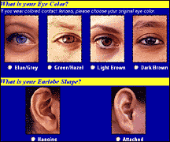
Traits
Traits are a person’s physical characteristics Ex: Eye color, hair color, etc…

Slide 6
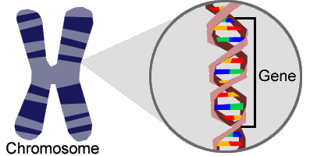
Genes and Your Traits
Genes appear as dark bands on the chromosomes and determine your traits.
How many genes does this chromosome have?

Slide 7
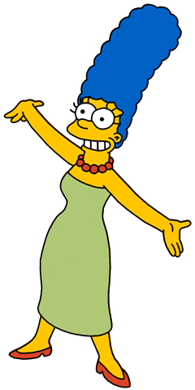
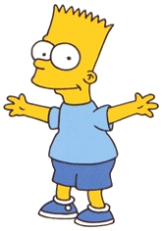
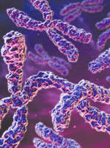
Inheritance
During Fertilization each parent’s sex cell (gamete) contributes half the chromosomes to the offspring.
23
23

Slide 8
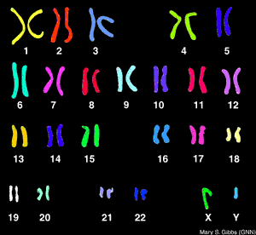
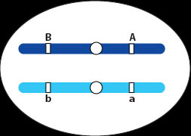
Results of Fertilization
The offspring has 46 chromosomes
Why do we have two of each chromosome?
SEX CHROMOSOMES
Offspring will receive two copies of each chromosome, one from dad and one from mom. These are called Homologous Chromosomes.

Slide 9
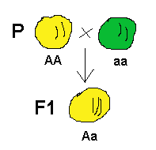
Alleles
The different forms of a gene. They can be dominant or recessive.
GENE FOR PEA COLOR HAS TWO ALLELES:
GREEN & YELLOW

Slide 10
DOMINANT & recessive
Dominant genes are indicated with a CAPITAL letter, while recessive genes are indicated with lowercase letters.
Dominant alleles will be seen over the recessive alleles.

Slide 11
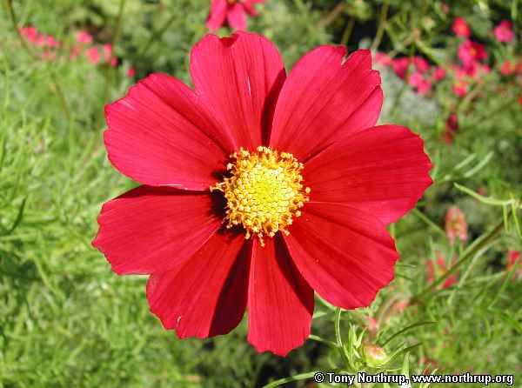
Dominant or recessive?
RR–
Rr–
rr–
(Dominant)
(Dominant–R show through)
(recessive)

Slide 12
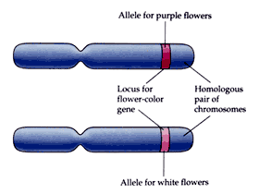
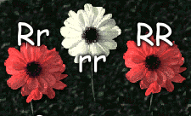
Genotype determines Phenotype
Genotype: pair of genes (RR, Rr, rr)
Phenotype: physical appearance

Slide 13
When will the recessive allele show in the phenotype?
Two recessive alleles must come together (one from each parent). In other words, a recessive trait will only appear when two lowercase letters are together.

Slide 14
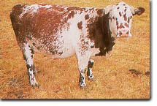
Codominant
Both alleles appear in the phenotype together.
Two examples: Blood Type and Roan Cattle.
Brown & White
alleles

Slide 15
Homozygous – two of the same alleles -two dominant (TT) -two recessive (tt) Heterozygous – two different alleles -one of each (Tt)

Slide 16
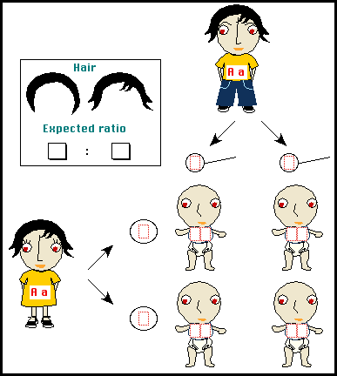
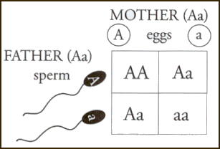
How can we predict genotypes and phenotypes of offspring?
AA
Aa
Aa
aa

Slide 17
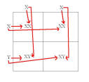
Punnett Squares
BB
Bb
Bb
bb
b = white fur

Slide 18
Summary
Find the percentages for genotypes and phenotypes for each cross.
In guinea pigs, black coat color is dominant over to brown coat color. Cross a black male guinea pig (Bb) with a brown female (bb).
Bb | Bb
bb | bb

Slide 19
Basic Genetic Concepts & Terms
Notes:
This set of slides can be used as a review or introduction of basic genetic concepts that students should know before the Lessons 1 and 2.

Slide 20
Genetics: what is it?
What is genetics?
“Genetics is the study of heredity, the process in which a parent passes certain genes onto their children.”
What does that mean?
Children inherit their biological parents’ genes that express specific traits, such as some physical characteristics, natural talents, and genetic disorders.
Notes:
Conduct a brief class discussion to assess students’ knowledge and assumptions about genetics, while providing the information to those students who may not have any prior knowledge.

Slide 21
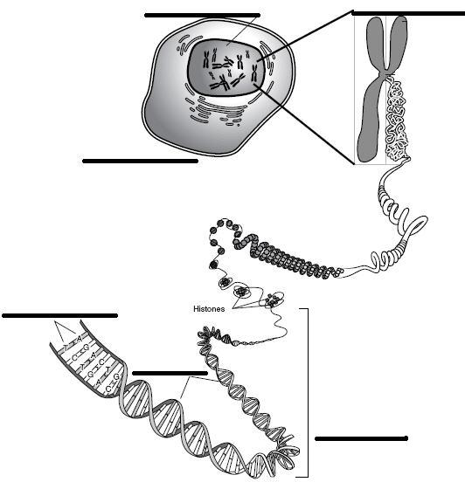
Word Match Activity
Match the genetic terms to their corresponding parts of the illustration.
base pair
cell
chromosome
DNA (Deoxyribonucleic Acid)
double helix*
genes
Nucleus
Notes:
Hand out the Word Match Activity worksheet and ask students to work in pairs to complete the worksheet.
* Tell students that “double is paired with another term, and that both terms should be placed in one of the six areas indicated on the illustration.

Slide 22
Word Match Activity
base pair
cell
chromosome
DNA (Deoxyribonucleic Acid)
double helix*
genes
nucleus
Illustration Source: Talking Glossary of Genetic Terms http://www.genome.gov/glossary.cfm?key=chromosome
nucleus
chromosome
cell
base pair
(double helix)
DNA
genes
Notes:
Have students volunteer the answers and clarify that “double helix” is the structure of DNA.

Slide 23
Genetic Concepts
H describes how some traits are passed from parents to their children.
The traits are expressed by g , which are small sections of DNA that are coded for specific traits.
Genes are found on ch ___.
Humans have two sets of _ (hint: a number) chromosomes—one set from each parent.
Notes:
Use this overhead for students to complete the 4 sentences.

Slide 24
Genetic Concepts
Heredity describes how some traits are passed from parents to their children.
The traits are expressed by genes, which are small sections of DNA that are coded for specific traits.
Genes are found on chromosomes.
Humans have two sets of 23 chromosomes—one set from each parent.
Notes:
Have students volunteer their answers, and help students understand that the inherited traits are passed from one generation to the next as the parents’ chromosomes are copied and passed to their children.

Slide 25
Genetic Terms
Use library resources to define the following words and write their definitions using your own words.
allele:
genes:
dominant :
recessive:
homozygous:
heterozygous:
genotype:
phenotype:
Mendelian Inheritance:
Notes:
Optional: For this task, pre-arrange with a school librarian or media specialist to provide students with the computers with the web sites, “Talking Glossary of Genetic Terms” (http://www.genome.gov/10002096) and/or “DNA from the Beginning’s Classical Genetics” (http://www.dnaftb.org/dnaftb/), in addition to other reference materials student pairs can used to complete the task.
Hand out the Basic Genetic Terms worksheet and provide reference materials for students to use in completing the worksheet.
Have student pairs take turns in sharing their definitions and examples of the terms. (See the Basic Genetic Terms for Teachers for sample definitions and examples.)

Slide 26
Mendelian Inheritance
The inherited traits are determined by genes that are passed from parents to children.
A child inherits two sets of genes—one from each parent.
A trait may not be observable, but its gene can be passed to the next generation.
Notes:
Review key concepts of Mendelian Inheritance with students. For #3, ask students what situations may call for an unobservable trait to be passed from parents to children. Students may be able to apply their understanding of dominant and recessive traits where parents with both dominant and recessive traits only show dominant traits while being able to pass their recessive traits to the next generation.

Slide 27
Mendelian Inheritance
Each person has 2 copies of every gene—one copy from mom and a second copy from dad. These copies may come in different variations, known as alleles, that express different traits.
For example, 2 alleles in the gene for freckles are inherited from mom and dad:
allele from mom = has freckles (F)
allele from dad = no freckles (f)
child has the inherited gene pair of alleles, Ff (F allele from mom and f allele from dad).
Notes:
Review with students the term “allele” (a variant form of a gene) and help students understand that each gene has a pair or two alleles—one allele from mom and the other from dad.

Slide 28
Do Now
A heterozygous female rabbit with brown fur is crossed with a homozygous recessive male with white fur. List the percentage of each genotype and phenotype.

Slide 29
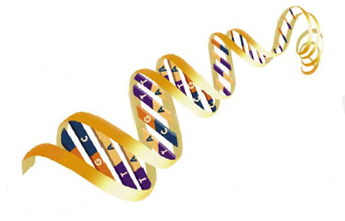
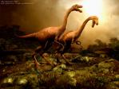
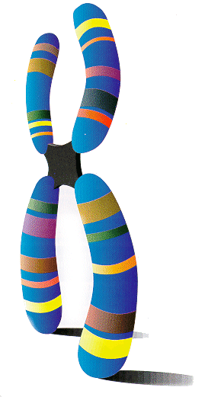
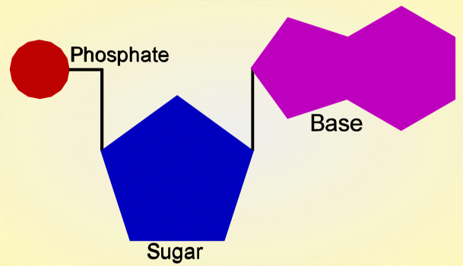
Aim: How does DNA carry the genetic code?
Do Now: 1. Take out HW
2. What do you know about DNA?
HW: Worksheet

Slide 30
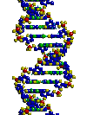
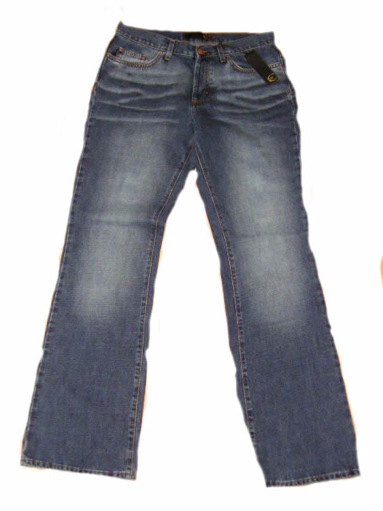
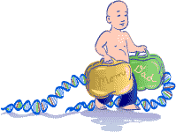
Why is DNA important?
Deoxyribo Nucleic Acid
Because it carries the instructions on how to make living things.
Contains hereditary information.

Slide 31
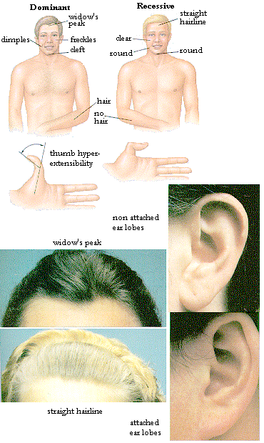
How do we get our traits?
They are passed from generation to generation on our genes.
Genes are found on x-shaped structures called chromosomes. Each stripe represents a different gene. (Genes are made of DNA)
Chromosomes are made of genes, genes are made of DNA

Slide 32
DNA → genes → Chromosomes

Slide 33
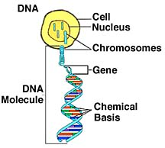
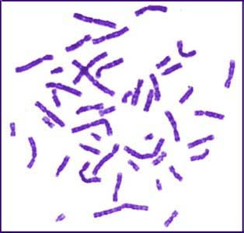
How many genes and chromosomes do we have?
We have thousands of genes on 46 chromosomes, packed inside the nucleus of each cell
Somatic (body) cells have 46 chromosomes, sex (egg and sperm) cells have 23. Each parent gives half.

Slide 34
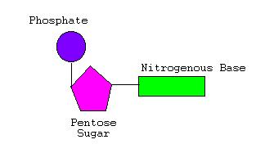
How can we describe the structure DNA?
It is a double helix (twisted ladder) made of repeating nucleotides.
The structure of DNA allows it to carry the genetic code
Sugar-phosphate side chain and nucleotide base pairs

Slide 35
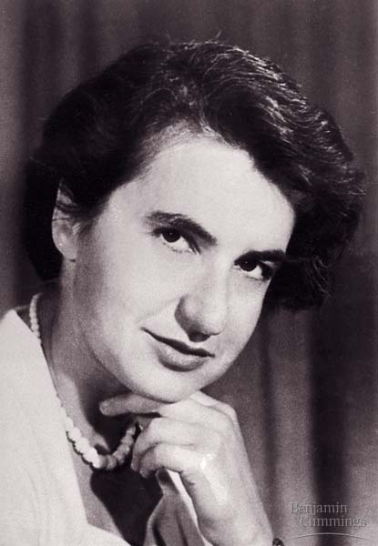
DNA Structure
Roslyn Franklyn
Double-Helix – twisted ladder
Nobel Prize work on DNA
Maurice Wilkins
Watson & Crick

Slide 36
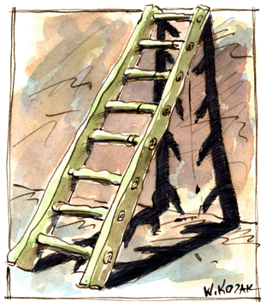
Types of Nitrogenous Bases
How do the bases pair up?
T
Adenine (A)
Thymine (T)
Guanine (G)
Cytosine (C)
All …. Teachers
Go …. Crazy
A – T and G - C

Slide 37
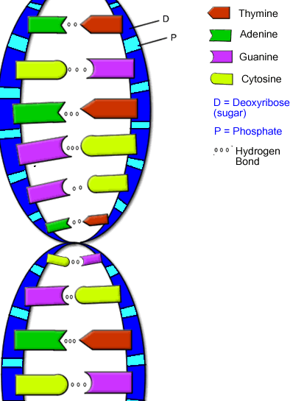
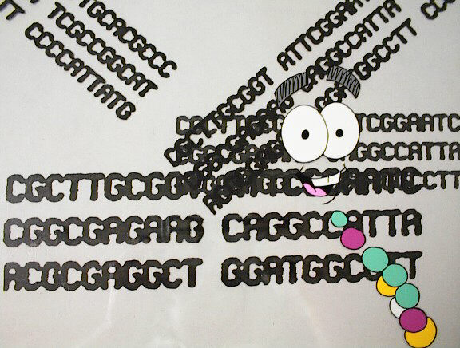
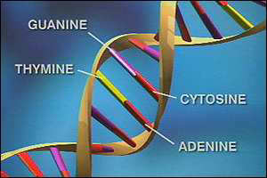
The Genetic Code
The base sequence holds the genetic code.
Each organism has a different sequence of bases making every organism UNIQUE (just think of the combinations).

Slide 38
DNA Structure
What is DNA
composed of?
4 types
Adenine
Thymine
Guanine
Cytosine
Deoxyribose
Nucleotides

Slide 39
DNA Structure
Double-Helix
Watson & Crick
Nobel Prize work on DNA

Slide 40
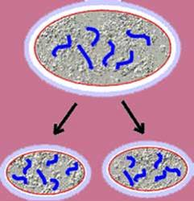
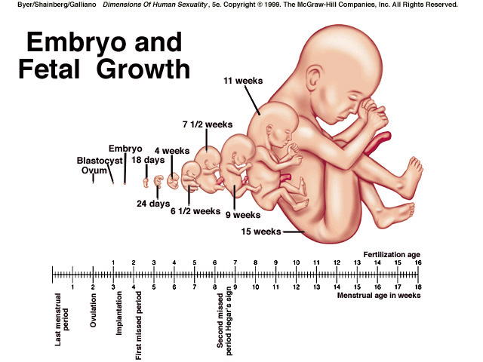
Why do you think cells have to divide?
Cells must divide in order to grow and repair the body.
Cell division=one cell becomes two.

Slide 41
Aim: How is DNA replicated?

Slide 42
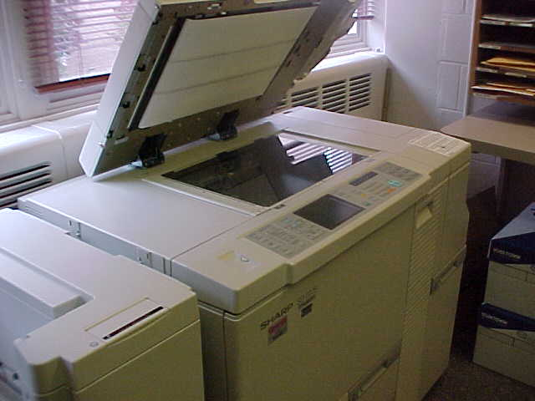
DNA Replication
What does REPLICATE mean?
Replicate means to make an exact Copy of something.
When DNA replicates, it makes an exact copy of itself according to the base pairing rules.
(Hint)

Slide 43
DNA Structure Review
What is DNA
composed of?
4 types
Adenine
Thymine
Guanine
Cytosine
Deoxyribose
Nucleotides

Slide 44
DNA Structure
Double-Helix
Watson & Crick
Nobel Prize work on DNA

Slide 45
Cell Division
Why do you think cells have to divide?
Cells must divide in order to ________ and _______ the body.
grow
repair

Slide 46
What does the DNA do before a cell divides?
Genetic Information
(DNA)
DNA must replicate
before a cell divides.
DNA is the “Blueprint” for all cell activities. Each cell needs the entire “Blueprint” to function properly.

Slide 47
What are the Steps of DNA Replication?
Step 1: Bonds between the bases are broken
and the DNA Molecule is “Unzipped”, creating two separate strands.
G - C
C - G
T - A
A - T
T - A
DNA Molecule
G C
C G
T A
A T
T A
2 Separate Strands
Bonds
Broken

Slide 48
What are the Steps of DNA Replication?
Step 2: Individual bases find their “match” on
each single strand of DNA. Each strand is a template for the base pairing.
G C
C G
T A
A T
T A
2 Separate Strands
G
C
T
A
T
C
G
A
T
A
G
C
T
A
T
C
G
A
T
A
Base
Pairing
Enzymes

Slide 49
What are the Steps of DNA Replication?
Step 3: The hydrogen bonds between the bases are formed.
G C G C
C G C G
T A T A
A T A T
T A T A
G - C G - C
C - G C - G
T - A T - A
A - T A - T
T - A T - A
Bonds
Formed

Slide 50
DNA Replication Review
G C
C G
T A
A T
T A
2 Separate
Strands
-
-
-
-
G - C
C - G
T - A
A - T
T - A
DNA
Molecule
G C G C
C G C G
T A T A
A T A T
T A T A
-
-
-
-
Bonds
Broken
Base
Pairing
Hydrogen Bond Formation

Slide 51
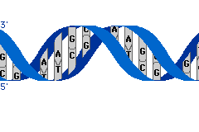
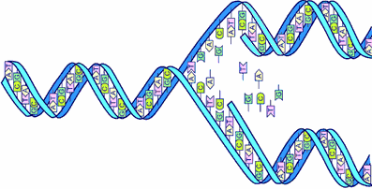
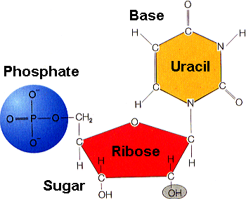
Aim: How are proteins synthesized using the genetic code?

Slide 52
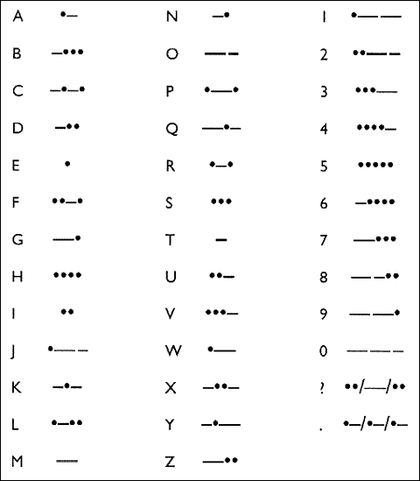
Morse Code
-.-- .- -. -.- . . …
How can you decode this message?
1st Copy Code
2nd Translate Code
.
dot
short sound
-
dash
long sound
http://www.philtulga.com/morse.html

Slide 53
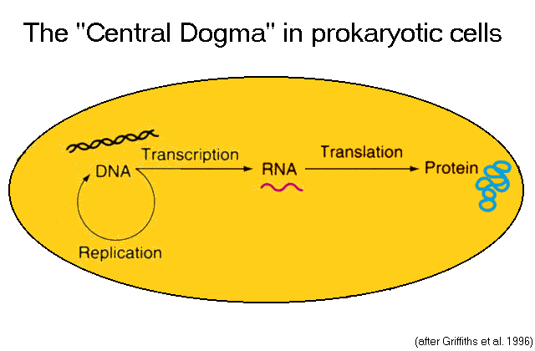
How can we change DNA into a protein?
First transcription occurs - DNA is copied into mRNA.
Second translation occurs - DNA is changed into proteins.
COPY
CHANGE

Slide 54
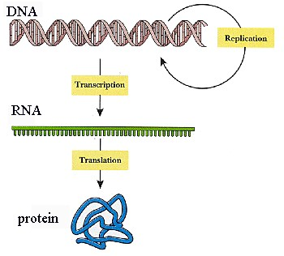
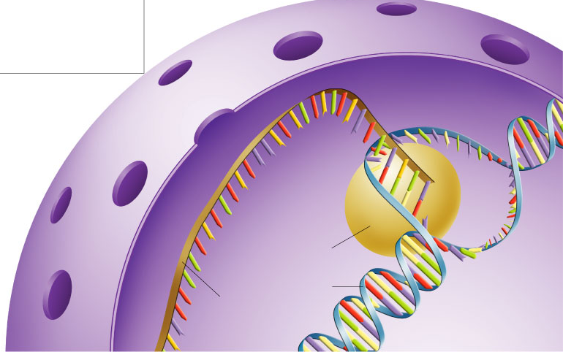
How is the genetic code TRANSCRIBED?
m
The DNA base sequence needs to get copied into messenger RNA (Ribonucleic Acid)

Slide 55
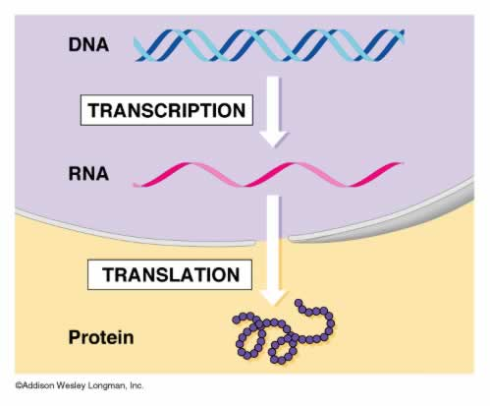
Why is transcription an important process?
Too Large to Leave the Nucleus
It converts the double stranded DNA molecule into a single stranded mRNA molecule that can leave the nucleus
mRNA

Slide 56
How is the genetic code TRANSLATED?
The mRNA copy needs to get changed into an amino acid sequence.
Amino Acids chained together make-up proteins.
m

Slide 57
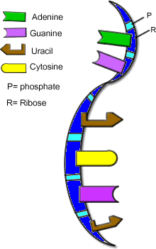
How do DNA and mRNA Compare?

Slide 58
DNA vs. RNA
DNA–main instructions
Double Helix
Sugar–Deoxyribose
Bases:
Adenine–Thymine
Guanine–Cytosine
RNA–copy of instructions
Single Helix
Sugar–Ribose
Bases:
Adenine–Uracil
Guanine–Cytosine

Slide 59
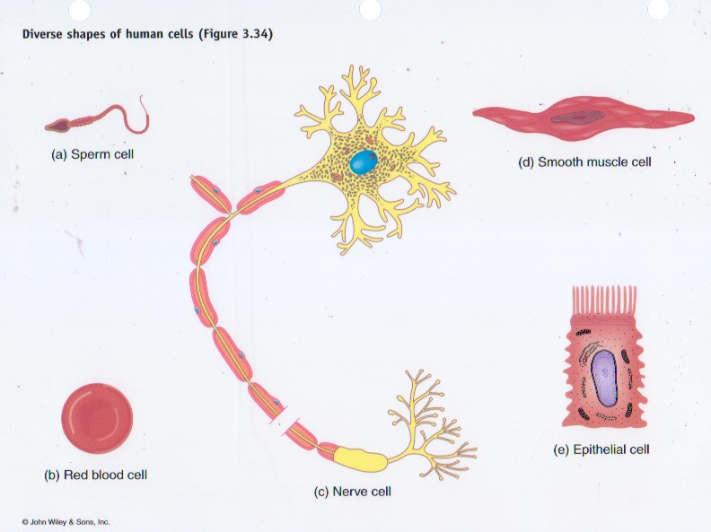
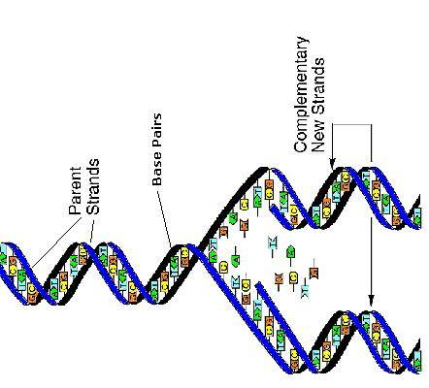
Aim: Why do different cells produce different proteins?

Slide 60
Cell Activity
If these cells came form the SAME person, do they ALL have the SAME DNA? Why or why not?
If ALL these cells have the SAME DNA, why are they different?

Slide 61
Why are all our cells different?
Cells are different from each other because they EXPRESS different portions of the genetic code (genes).
This means that different proteins are made by different cells causing them to look and function differently.

Slide 62
How does Gene Expression make our body cells different?
Every cell in our body has the same 30,000 genes, but each cell selectively activates (“turns on”) certain genes.

Slide 63
How do you think a gene expresses itself?
The Information on DNA (activated genes– those that are “turned on”) is translated into an organism's traits by producing specific proteins.
Protein

Slide 64
Why are twins “not exactly” alike?
Environmental factors such as temperature, pH, and availability of nutrients can influence the genes expressed in a cell.
Genes+Environment =Trait

Slide 65
Gene Expression
All the cells in our body have the exact same DNA because they all came from a single cell which replicated its DNA.
Although every cell in your body has the same DNA, not all cells are the same. Why?

Slide 66
Hydrangea
How does the environment affect hydrangea growth?
Depending on the pH of the soil, Hydrangea can range in color from blue to pink.

Slide 67
Himalayan Rabbits
If a small section of fur is shaved from a Himalayan Rabbit, the fur will grow back either white or black depending on the temperature of its environment .
HOT
COLD

Slide 68
Aim: How can mutations occur? Do Now: 1. Do all of your cells have the same DNA? 2. What makes a blood cell different than a skin cell?

Slide 69
How can we define the term “mutation”?
A mutation is a mistake in the DNA (base pair sequence) that can result in changes to the organism.

Slide 70
Why do mistakes in replication lead to mutations?
1 gene
1 Protein
Because each nucleotide base sequence (GENE) that is replicated codes for one protein, which then make-up our traits (characteristics).

Slide 71
When do you think most mutations occur? Why?
Mutations most commonly occur when DNA is being replicated.

Slide 72
How can a mutation affect an organism?
It changes the physical characteristic of the organism.
Normal Frog
Notes:
----- Meeting Notes (3/18/14 13:42) -----
zara was here

Slide 73
Hemophilia
Is a genetic disorder (mutations in a gene for clotting factors) of the circulatory system where your blood does not clot.
How can this be a problem?

Slide 74
Are you color blind?
Colorblindness (a condition where you can’t see certain colors) is another genetic disorder caused by a mutation in a gene.
A mutation occurs in the gene for special cells called cones that help you see color.

Slide 75
Can you identify any environmental sources that may lead to a mutation?
Chemicals
UV Radiation
X-Ray radiation

Slide 76
A mutation is a mistake in the genetic code
DNA base sequence:
a –
a –
t –
c –
c –
g –
t –
DNA base mutation:
a – t
a – t
t – a
a – t
c – g
g – c
t – a
t
t
a
g
g
c
a

Slide 77
Types of Gene Mutations
Include:
Point Mutations
Substitutions
Insertions
Deletions
Frameshift

Slide 78
Point Mutation
Change of a single nucleotide
Includes the deletion, insertion, or substitution of ONE nucleotide in a gene

Slide 79
Point Mutation
Sickle Cell disease is the result of one nucleotide substitution
Occurs in the hemoglobin gene

Slide 80
Frameshift Mutation
Inserting or deleting one or more nucleotides
Changes the “reading frame” like changing a sentence
Proteins built incorrectly

Slide 81
Frameshift Mutation
Original:
The fat cat ate the wee rat.
Frame Shift (“a” added):
The fat caa tat eth ewe era t.

Slide 82
Amino Acid Sequence Changed

Slide 83
Gene Mutation Animation

Slide 84
Practice Do Now: 1. What is a genetic mutation? 2. Why is a frameshift mutation bad? 3. What is hemophilia?

Slide 85
Normal Male
2n = 46

Slide 86
Normal Female
2n = 46

Slide 87
Male, Trisomy 21 (Down’s)
2n = 47

Slide 88
Female Down’s Syndrome
2n = 47

Slide 89
Klinefelter’s Syndrome
2n = 47

Slide 90
Turner’s Syndrome
2n = 45

Slide 91
Exit Ticket
What is Down’s Syndrome?
What is the difference between a chromosomal disorder and a genetic mutation?
What is the difference between asexual and sexual reproduction?
How is cloning a form of asexual reproduction?
In what way do humans perform asexual reproduction?

Slide 92
Aim: How can DNA be used to create genetically identical individuals?

Slide 93
Clones
A clone is an organism that is genetically identical to the organism from which it was produced.

Slide 94
Asexual vs Sexual Reproduction
Asexual: (a form of cloning)
Offspring have only one parent.
They have the same genetic information as the parent.
Sexual:
Offspring have two parents (union of sperm and egg).
They receive half of their genetic information from mom and half from dad.

Slide 95
Cloning vs Asexual Reproduction
Cloning is a technique that accomplishes the same end result as asexual reproduction.
What is the end result?
The production of offspring with identical genetic information as the parent.

Slide 96
Cloned Organisms
Scientists have recently been able to clone animals that normally reproduce sexually (Ex. Dolly and Beaker)
Hello Dolly!!

Slide 97
Which of the following are examples of cloning?

Slide 98
How is this done?
A nucleus of a cell from the organism you want to clone has to be removed.
An egg from a surrogate mother also has to be removed.
The nucleus and egg cell are then fussed (joined) to form an embryo.
The dividing embryo is then placed inside the surrogate mother and the pregnancy begins.
Birth of clone
1.
3.
2.
5.
4.

Slide 99
Why Clone?
1) Clone Stem Cells
2) Revive endangered or
extinct species
3) Reproducing a
deceased pet
4) Clone humans?

Slide 100
Extra Material:
Do you think identical twins are clones? Explain. Can you hypothesize how identical twins are formed?
Cloning Virtual Simulation
Cloning Video

Slide 101
Aim: How can genes be genetically altered? Do Now: 1. How is a clone different from a duplicate? 2. What is one argument for cloning? 3. What is one argument against cloning?

Slide 102
Review: Genes
Gene
A gene is a sequence of DNA on a chromosome that codes for ONE protein. Together, these proteins determine your traits.

Slide 103
Genetic Engineering
Genetic Engineering is a process that is
used to alter the genetic instructions of an organism.

Slide 104
Why would altering DNA affect our traits?
DNA codes for the proteins that determine our traits.
Change the DNA, change the protein (trait)

Slide 105
How is DNA altered?
Step 1: Desired DNA is first extracted (removed)
from cells.
DNA
Nucleus
Nucleus
…AGTTATTC…
…TCAATAAG…
DNA
+
…AGTTATT…
…TCAATAA…

Slide 106
How is DNA altered?
Step 2: Desired DNA is then cut into smaller pieces with Restriction Enzymes.
Restriction enzymes are “scissor-like” enzymes that recognize and cut specific sequences in the DNA.

Slide 107
What base sequences were these Restriction Enzymes specific for?
AGTTATTC
TCAATAAG
A GTTATTC
TCAATAA G
AG
GCATTACGTT
CGTAATGCAA
G CATTACGTT
CGTAATG CAA
GC

Slide 108
How is DNA altered?
Step 3: Desired DNA is combined with DNA from another organism (gene splicing).

Slide 109
Recombinant DNA
DNA that comes from two sources is made by genetic engineering.
Recombinant DNA
DNA from
Organism 1
DNA from
Organism 2

Slide 110
How is DNA altered?
Step 4: The recombinant DNA is then inserted into the nucleus of another organism (ex. bacteria).
+
Nucleus of
Organism we
Want to alter
Genetically
Engineered
organism
Recombinant
DNA

Slide 111
Why would scientists want to alter the genetic instructions of organisms?
+
Scientists can generate
organisms with desired
characteristics.

Slide 112
End Result: Once in the New Organism
The transferred genes direct the new organism’s cells to make the same protein as the original organism.
AND
Glowing Green Protein

Slide 113
Aim: How can genetic engineering create a DNA fingerprint?

Slide 114
How can CSI Investigators use DNA as a Fingerprinting?
DNA acts as a fingerprint because scientists and crime scene investigators use it to identify people.
What contains a person’s DNA?
The Nucleus of cells

Slide 115
How do scientists make a DNA Fingerprint?
Scientist need to find some
DNA of the perpetrator.
Where can the investigators find the DNA?
Blood
Hair
Nails
Skin

Slide 116
What if you only find very little DNA?
The sample of DNA is multiplied using a process called Polymerase Chain Reaction (PCR).

Slide 117
Gel Electrophoresis–Creating the DNA Fingerprint
DNA to be analyzed is cut with restriction enzymes into different sized fragments.
They are added to a gel and separated according to their size.
Result: The smaller segments of DNA are found closer to the end than the larger segments.
A
B
C
D
E
F
G

Slide 118
Gel Electrophoresis
-
DNA Suspect A Suspect B Suspect C from CS __ __ __ __ __ __ __ __ __ __ __ __ __ __ __ __ __ __
+

Slide 119
Who done it? Activity

Slide 120
Aim: How can chromosomal abnormalities cause genetic disorders?
Do Now: Inheritance Questions
HW: Test Friday
Page 353 Questions #1-4

Slide 121
Compare the 2 sets of chromosomes (karyotypes).

Slide 122
How can a karyotype be used to identify genetic disorders?
22 pairs of body chromosomes
A tool used by doctors to help diagnose genetic disorders due to chromosomal abnormalities.
All 46 chromosomes are arranged by number (22 homologous pairs and one pair of sex chromosomes).
1 pair of sex chromosomes

Slide 123
How do sex chromosomes determine gender?
There are two sex chromosomes (X and Y) which determine if you are a male or a female.
XX-Female
XY-Male

Slide 124
Where are sex linked genetic disorders carried?
Genes that are defective are carried on the X chromosome.
How do you think this effects males and females?

Slide 125
How would you describe someone who is a carrier of a genetic disorder ?
Carrier: person who has the recessive allele, but does not have the disease because the second allele is normal:
C c
If both parents are carriers, what percentage of children will have the disease?
Cc
Cc

Slide 126
Great Grandparents
Great Grandparents
Me

Slide 127
Pedigree Chart
A diagram that shows the presence or absence of a particular trait through each generation.
Cc
Cc
c
cc
Recessive gene on a body chromosome

Slide 128
Why do you think this is so important?
Scientists studied and mapped the human genome (determined the entire nucleotide sequence of DNA) if an effort to diagnose and cure disease.

Slide 129
Aim: How does selective breeding affect genetic variation?
+
=
Horse
Mule
Donkey

Slide 130
What is Breeding?
To produce viable offspring

Slide 131
Types of Selective Breeding
Artificial Selection
Crossbreeding
Inbreeding

Slide 132
Artificial Selection
Selecting for desirable traits in offspring by choosing organisms (of the same species) to mate.
Ex: Dairy farmers may choose to mate only cows that give the most milk.

Slide 133
Artificial Selection

Slide 134
Crossbreeding
Also called hybridization
Individuals that are not closely related are combined (mated) to bring together two different desirable traits.
+

Slide 135
Real Example of Hybridization:
Hybrid
+
=
Horse
Donkey
Mule
Big, Fast,
Excitable
Small, Slow,
Calm
Medium Size,
Endurance,Temperamental
The hybrid is often stronger and hardier than its parents: Hybrid Vigor

Slide 136
Other Hybrids
Liger
Whalfin

Slide 137
Inbreeding
Mating of closely related organisms.
Decreases variation
Ex: In purebred dogs and cats, breeders try to maintain certain traits.

Slide 138
Advantages and Disadvantages of Inbreeding
Advantages:
organisms with desirable traits, like resistance to disease, or the ability to adapt to various climates.
Disadvantages:
recessive disorders tend to increase.
Ex: Hip dysplasia (hip joint degenerates) in certain dog breeds.
Notes:
----- Meeting Notes (4/3/14 12:08) -----
zara was here <3

Slide 139
Recessive Disorders
An inherited disorder
that occurs when the
offspring receives
a “bad” gene from each
parent.

Slide 140
Benefits of Selective Breeding
Production of crops resistant to
disease.
2) Production of crops that are bigger.
Produce animals that have less fat.
4) Seedless fruit!!!

Slide 142
Genetic Engineering vs Selective Breeding
Genetic engineering requires the altering of genes to get desired characteristics.
Selective Breeding utilizes natural reproduction to get desired characteristics.

Slide 143
Real Example of Hybridization:
Disease Resistant Potatos
Burbank’s hybrid crosses combined
the disease resistance of one plant
with the food-producing capacity
of another.
1872 - American horticulturist Luther Burbank (1849-1926) developed a special potato. Burbank, while trying to improve the Irish potato, developed a hybrid that was more disease resistant. He introduced the Burbank potato to Ireland to help combat the blight epidemic.

Slide 144
How do you think we can perform artificial selection?
Selecting for desirable traits in offspring by choosing organisms (of the same species) to mate.
Ex: Dairy farmers may choose to mate only cows that give the most milk.

Slide 145
Artificial Selection

Slide 146
Aim: How can we describe different patterns of inheritance?
Do Now: Genetic Engineering Question Worksheet
HW: Page 348 Questions #1-4
Test Friday

Slide 147
Polygenic Traits
Most traits are the result of the action of many genes (One trait = many genes).
For example, skin color & height depend upon the interaction of many independent genes.

Slide 148
Skin Color and Pigmentation
There is a brown pigment called melanin. We all have the same base skin color, just different amounts of melanin (determined by polygenic traits). Albinos have no melanin, so they have very white skin.
Notes:
If you have only a little melanin, you have white skin. If you have very black skin, it is because your skin makes a lot of melanin. Brown skin comes from all the variations you can get between white and black. If you are Chinese, your skin is slightly thicker which gives your skin a yellowish shade. No matter the color, it all comes from melanin.

Slide 149
Multiple Alleles
More than two alleles control the gene in some cases.
Blood type has three different possible alleles.
A, B, and O.
Which allele do you think is recessive? Dominant? Why?
AA or Ao
BB or Bo
AB
oo

Slide 150
Genes vs. Environment
Many traits are strongly influenced by environmental factors, including nutrition and exercise.
Phenotype = Genes + Environment
Nature
Nurture

Slide 151
Disease
Analyze the following statement - “Heredity loads the gun and environment pulls the trigger!”
Example: While diabetes might be due to a “bad” gene, our environment (personal habits & diet) can be important it its severity.
Notes:
While some cancers, heart disease and diabetes run in families and may be due to "bad" genes, other things are at work too. Our environment, our care in using chemical products, our personal habits, and our diet and exercise can be important.

Slide 152
Why are they different?
Grown in light
Grown in dark

Slide 153
Which of these traits is least affected by nature? Why?
Height
Artistic ability
Intelligence
Eye color

Slide 154
Aim: How can we apply our knowledge of genetics?

Slide 155
Station 1: Transcription and Translation
.
Determine the mRNA sequence from the DNA sequences provided.
Using the chart, determine the amino acid sequence in the protein.
Answer the questions on the worksheet based on the activity.

Slide 156
Station 2: Gene Splicing

Slide 157
Station 3: Gel Electrophoresis
Take the DNA strip and cut in the middle C and G in the CCGG sequence. (There are three CCGG sequences in the strip so you will have to make 3 cuts in the strip, which will make 4 DNA segments).
Count the number of bases in each DNA fragment and arrange them according to size.
Shade in the boxes (on the page labeled simulated electrophoresis gel) under the unknown organism column that corresponds to the number of bases in each strip. (E.g. If there are three bases in one of the strips, shade in box 3).

